Slide 1



An Edge Computing-Based and Threat Behavior-Aware Smart Prioritization Framework for Cybersecurity Intrusion Detection and Prevention of IEDs in Smart
Grids

Slide 2
INTRODUCTION
Smart grids, integrating IEDs, improve efficiency but also pose cybersecurity challenges. Traditional systems rely on centralized processing, causing delays. A decentralized edge computing approach, combined with advanced machine learning models, ensures real-time threat detection and prioritization, allowing operators to focus on critical issues.
The aim is to develop a real-time cybersecurity system for smart grids, combining edge computing with advanced machine learning models like modified LightGBM and One-Class SVM, enabling faster responses to potential attacks and ensuring grid security.

Slide 3

MODEL ARCHITECTURE
Preprocessing Layer
Cleans and prepares data for analysis
Smart Prioritization Module
Prioritizes alerts for timely action
Alerting & Control Actions
Final actions based on processed data
LGBM + One-Class SVM detection
Detects anomalies in data
Edge Devices / IEDs
Collects raw data from the environment

Slide 4
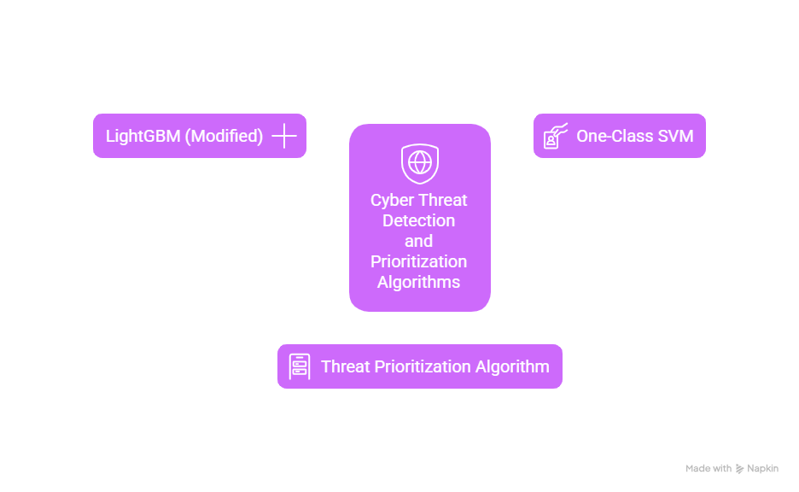

ALGORITHM
Decision Tree-Based
Classifies Known Cyberattacks
Anomaly Detection
Detects Unknown Threats
Custom Ranking
Ranks Threats by Severity

Slide 5
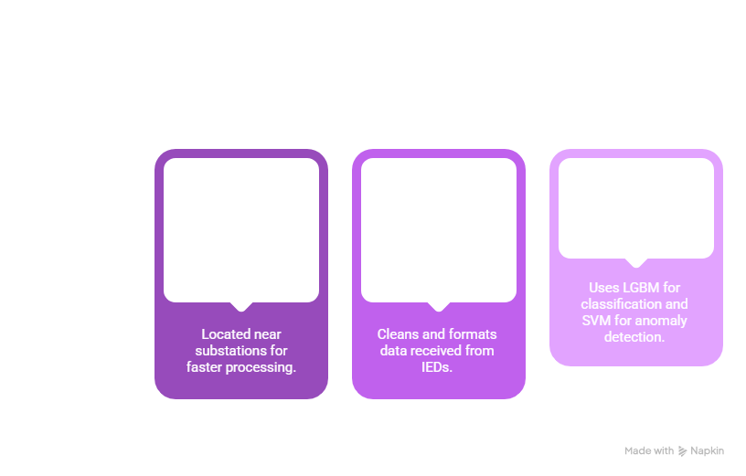
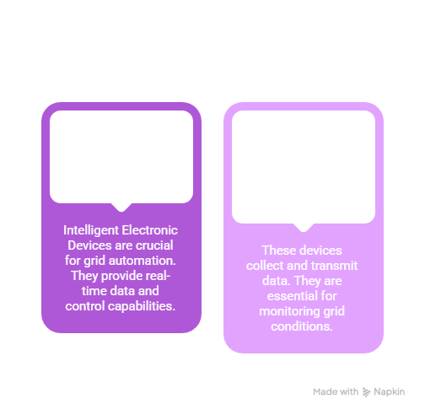
DESIGN
Smart Grid Layer (Field Devices)
Edge Node Layer

Slide 6
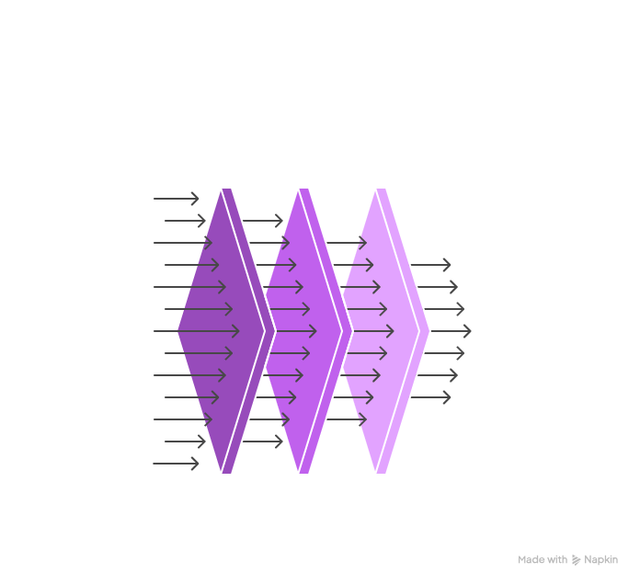
DATASET
KDDTrain.csv
Raw Network Traffic Data
Labeled Network Traffic
Train.csv & Test.csv

Slide 7

APPLICATION
Data Preprocessing
Model Training
Model Selection
Performance
Evaluation

Slide 8
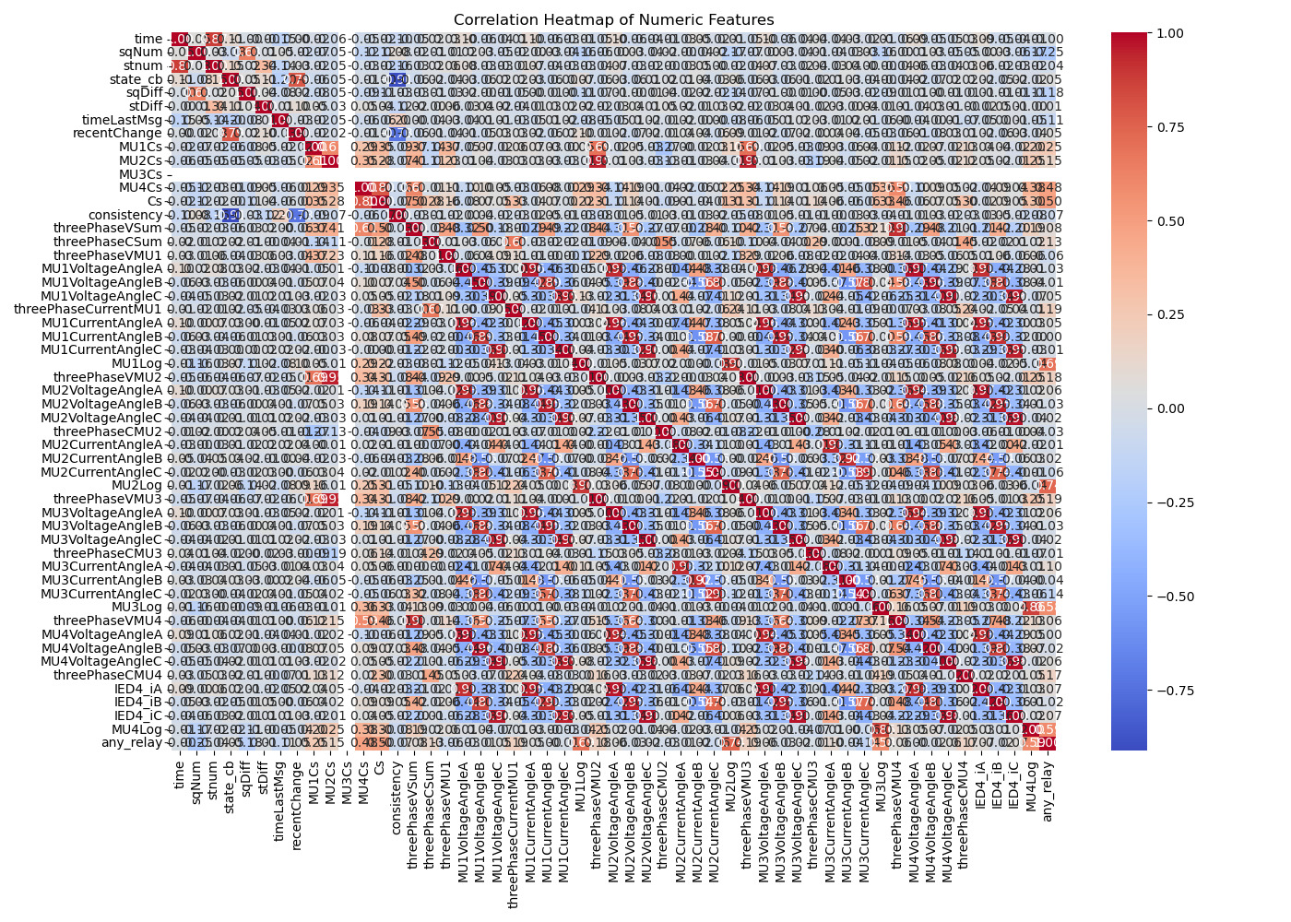
DATASET EVALUATION

Slide 9
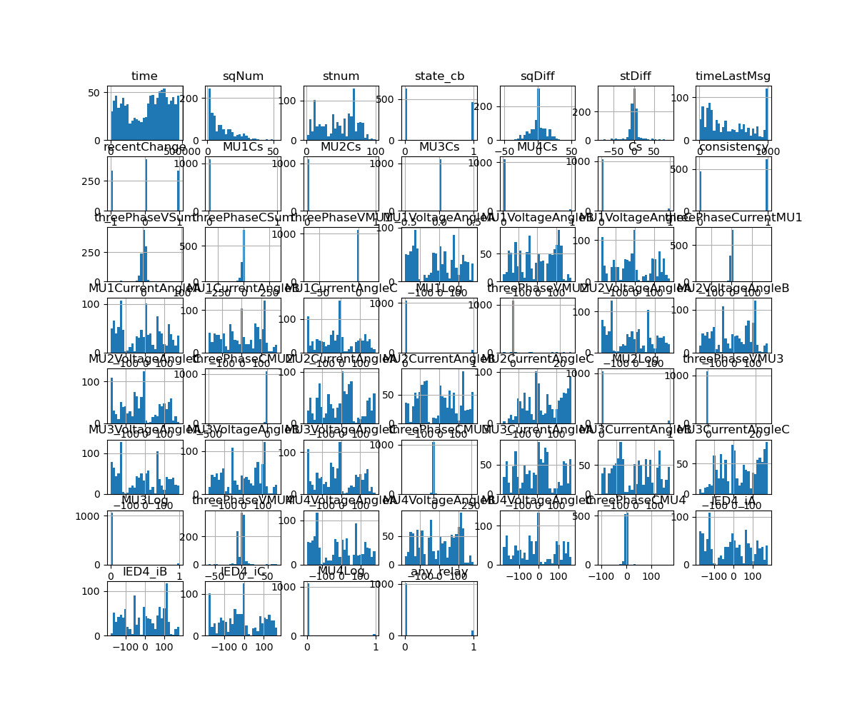
HISTOGRAM

Slide 10
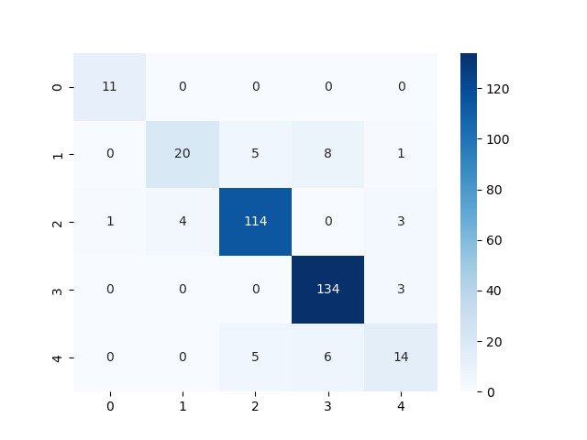
ML MODULE EVALUATION
Training Random Forest... Random Forest Classification Report: precision recall f1-score support
Random Forest Confusion Matrix:
Fault 0.91 0.91 0.91
Injection 1.00 0.35 0.52
Masquerade 0.88 0.99 0.93
Normal 0.82 0.99 0.90
Replay 0.00 0.00 0.00
accuracy 0.85
macro avg 0.72 0.65 0.65
weighted avg 0.80 0.85 0.80

Slide 11
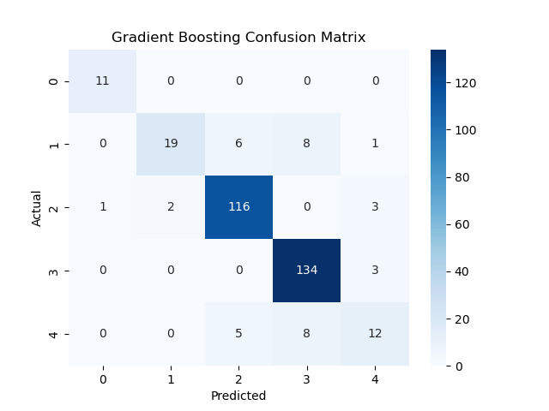
Gradient Boosting Confusion Matrix:
Training Gradient Boosting...
Gradient Boosting Classification Report:
precision recall f1-score support
Fault 0.92 1.00 0.96 11
Injection 0.90 0.56 0.69 34
Masquerade 0.91 0.95 0.93 122
Normal 0.89 0.98 0.93 137
Replay 0.63 0.48 0.55 25
accuracy 0.89 329
macro avg 0.85 0.79 0.81 329
weighted avg 0.88 0.89 0.88 329

Slide 12
LightGBM Confusion Matrix:
Training LightGBM...
LightGBM Classification Report:
precision recall f1-score support
Fault 1.00 1.00 1.00 8
Injection 0.93 0.65 0.76 20
Masquerade 0.94 1.00 0.97 80
Normal 0.90 0.98 0.94 91
Replay 0.85 0.55 0.67 20
accuracy 0.92 219
macro avg 0.92 0.84 0.87 219
weighted avg 0.92 0.92 0.91 219

Slide 13


Slide 14
FUTURE SCOPE
AI-based Threat Prediction Models
Blockchain- based Security
Improves data integrity and authentication
Predicts cyberattacks before they occur
Expansion to Other Infrastructures
Deep Learning for Anomaly Detection
Applies the framework to smart cities, industrial IoT, and healthcare
Uses CNNs and LSTMs for better attack pattern recognition

Slide 15
CONCLUSION
The integration of edge computing and a smart prioritization framework significantly enhances cybersecurity strategies. By employing advanced detection techniques and algorithms like modified LGBM and One-Class SVM, organizations can proactively identify and mitigate threats in a timely manner

Slide 16



THANK YOU

